Slide 1
OPW’s Petro Vend 100®
Fuel Control System
Overview, Features and Benefits

Slide 2
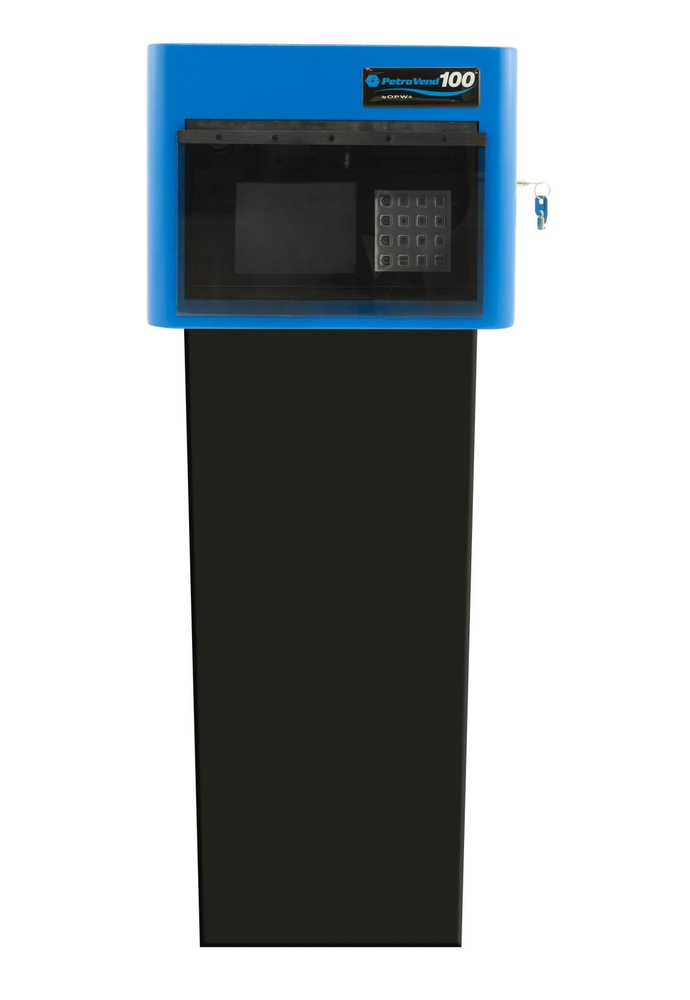
Product Introduction
The Petro Vend 100® Fuel Control System provides
one- or two-hose control to small or mid-sized fleet fueling sites from a user-friendly stand-alone pedestal mounted system.
Easy to Install: Designed for quick start-up, the Petro Vend 100 ships ready-to-use.
Easy to Use: The terminal features a simple graphic display that enables access to fueling data.
Cost-Effective: Limited wiring connections reduce installation expenses.
Upgradeable: With several options available, the Petro Vend 100’s already robust feature set can be easily expanded .

Slide 3
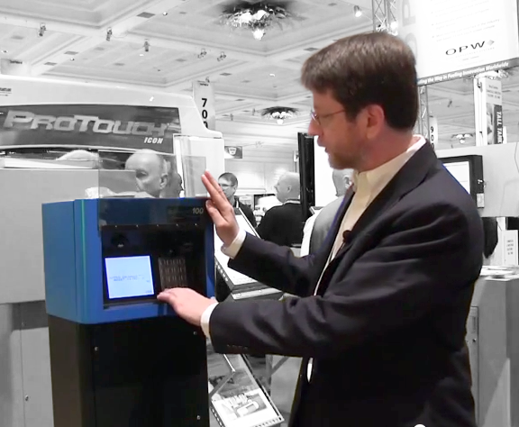
Key Benefits
The Petro Vend 100® Fuel Control System provides
Convenient Control of Fueling
Facilitates oversight of authorization and inventories at unattended fueling sites
Dispensed fuel can be recorded at both a card- and pump-specific total.
Offers hose-based quantity restrictions
Turnkey system is designed for quick and easy installation

Slide 4

Key Benefits
The Petro Vend 100® Fuel Control System is
AEconomical yet Effective ffordable yet Reliable
The Nano’s list price is lower than most comparable competitive alternatives
OPW’s advanced technology ensures accurate inventory,
alert and leak-detection data
Multi-drop technology
substantially reduces
installation costs
Remote accessibility allows
for a reduction in monitoring
labor and training costs

Slide 5

Key Benefits
The SiteSentinel® PV100™ is
Easy to Install
Comes out of the box
fully functional
Small equipment footprint
is ideal for tight spaces
Multi-drop technology
minimizes site wiring
infrastructure and
installation labor

Slide 6
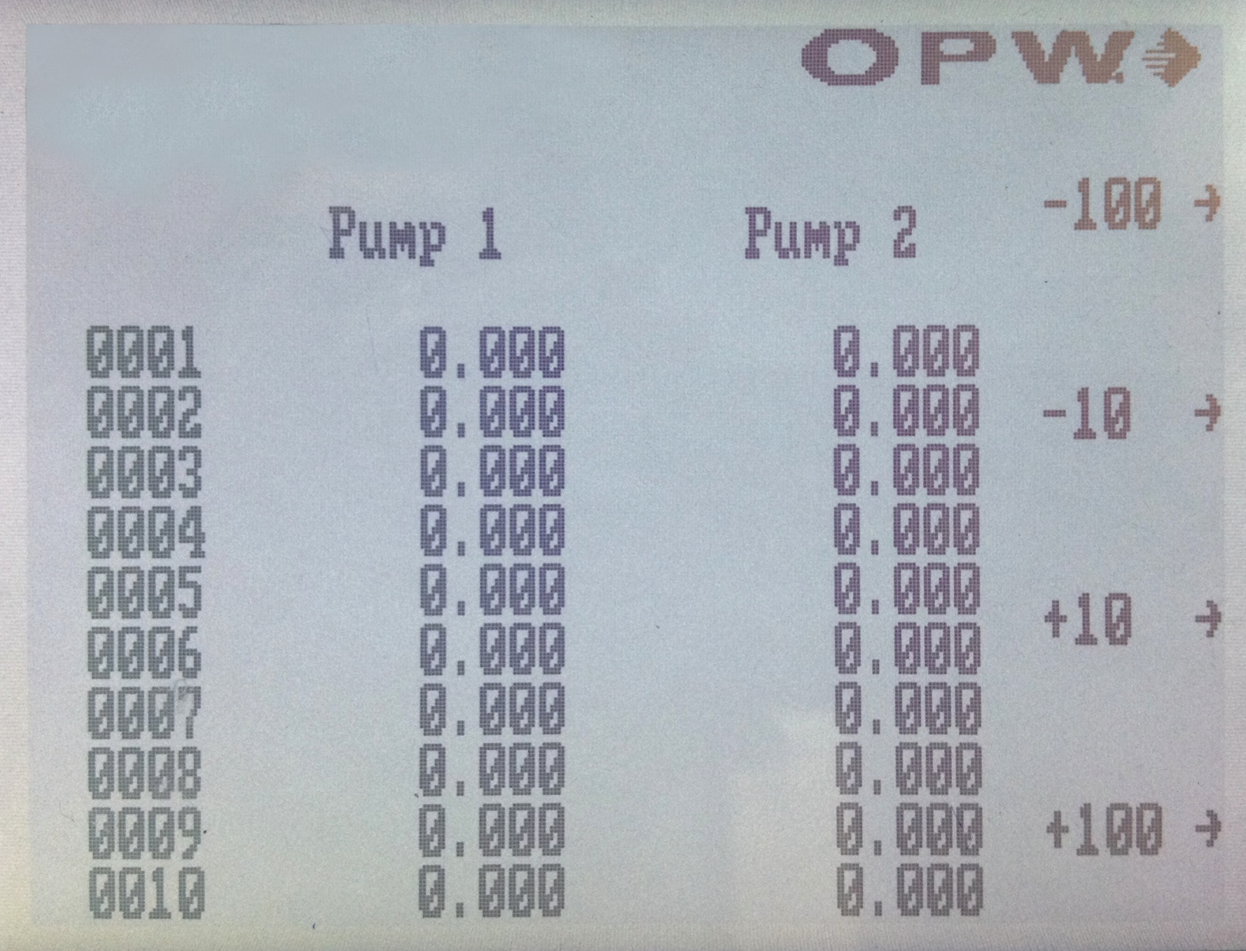
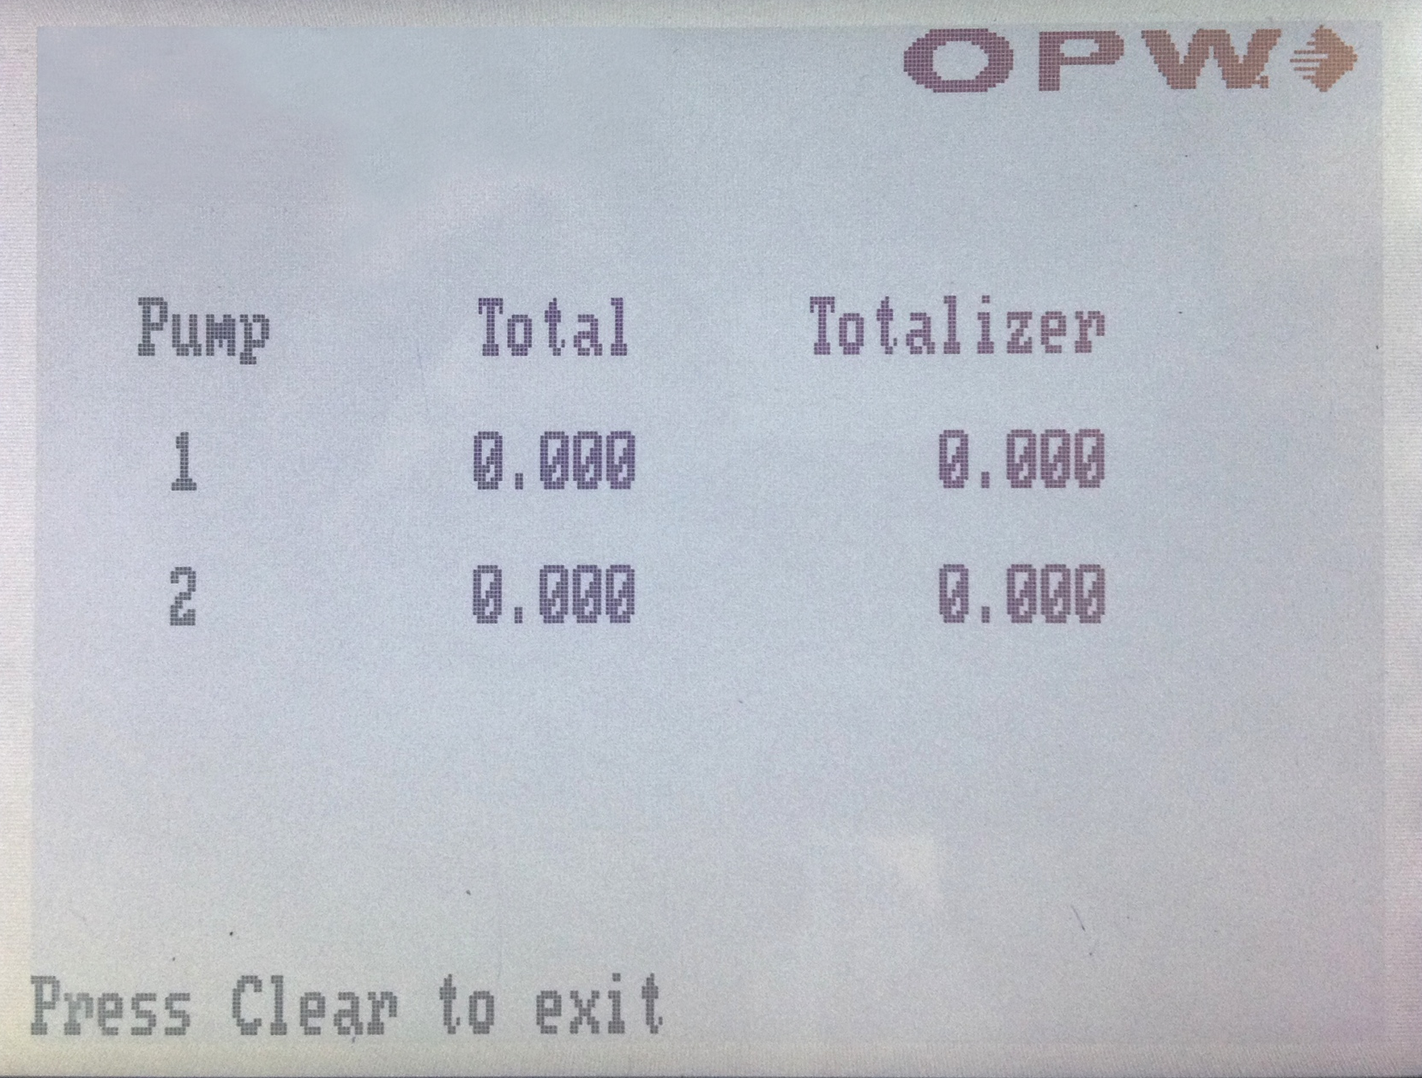
Features and Specifications
Software Functionality
Shows up to moment inventory, water and temperature data for each of your tanks.
Allows you to easily see your alarms, alerts and deliveries, and when they occurred, on a day-by-day basis.
Shows a list of your most common exception and event filter settings.

Slide 7
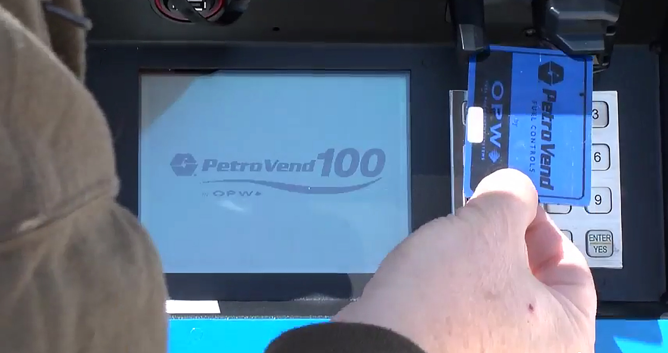
Features and Specifications
Multi-Drop Technology
Multiple probes and sensors
can be run back to the gauge on wire
Reduces amount of wiring
needed for a significant savings
on wire expenses
Less wiring makes for a less
labor intensive installation
Decreases site downtime
needed for gauge
installation or maintenance

Slide 8

Features and Specifications
Remote Accessibility
Access data and interact with the gauge, from anywhere, on most devices
Facilitate remote
training programs and processes
Remote Support technicians can troubleshoot problems in real time
Software updates and upgrades can
be implemented remotely

Slide 9
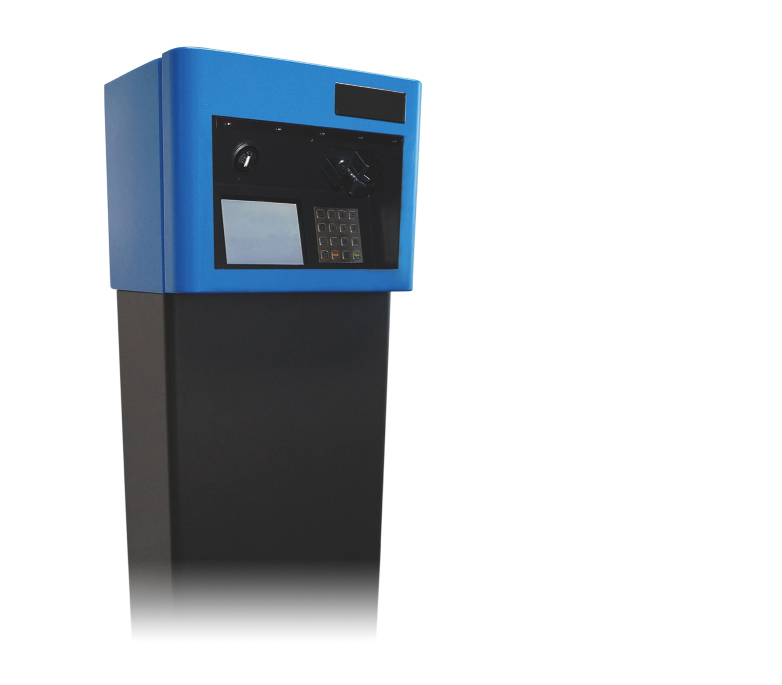
Features and Specifications
Small Equipment Footprint
Console’s small profile makes it ideal for tight spaces
Provides the flexibility to be placed where ever is most convenient for access
Accommodates 12 probes and 24 sensors making the small gauge capable of monitoring larger sites
Despite it’s small footprint, the gauge boasts a user-friendly 18cm (7”) touchscreen

Slide 10
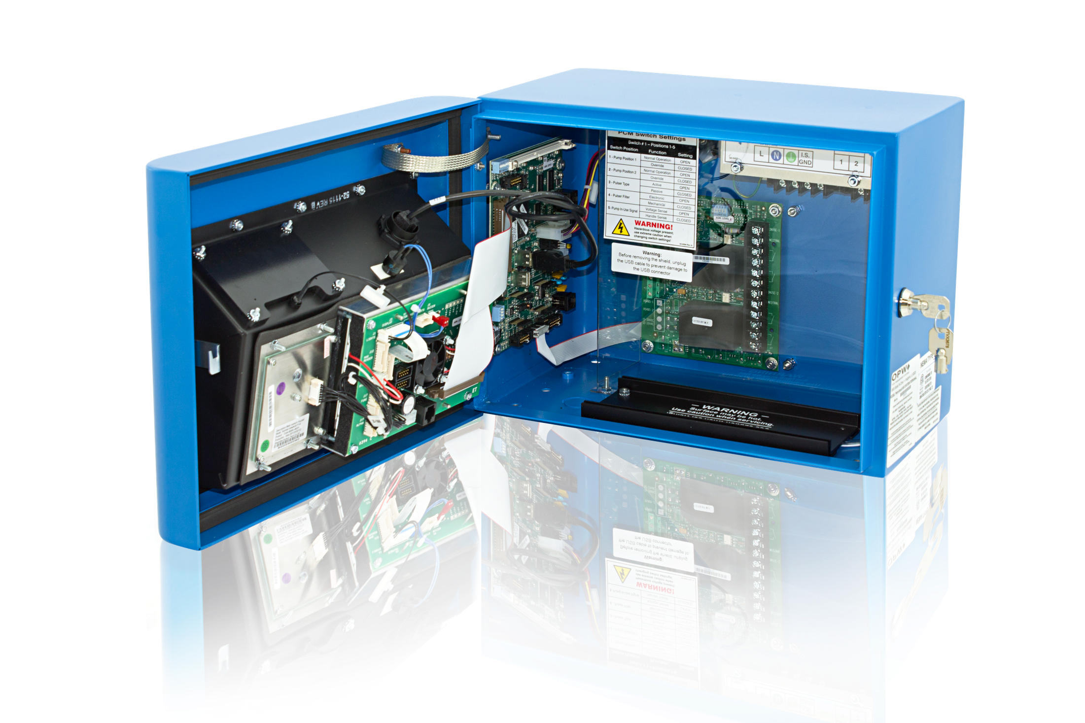
Features and Specifications
Dimensions and Display:
2 1 c m H x 3 2 . 5 c m W x 6 c m D
18 (7”) cm color LCD touchscreen display
Graphical user interface
Operating Requirements:
Power: 120/240 VAC +/- 10%, 50/60 Hz, 20 W
Operating Temperature Range: 0°C to 50°C
Alarms:
Standard Alarms: Buzzer, Light and Acknowledge
Optional Alarms: External Tank Alert (internal relay)
Reporting:
Alarm Notifications: Email, Fax, SMS
Printer: External USB
Connectivity and Communication Ports:
Network Connectivity: DHCP/static addressable RJ-45 Ethernet ports, supports corporate and local LANs
Communication Ports:
  One (1) RS-232 Communication port
  One (1) RS-485 Communication port
  One (1) RS-422 Communication port
  One (1) Ethernet port
  Two (2) USB ports
  Two (2) Internal inputs
  Two (2) Internal outputs

Slide 11
Q & A
Q
What kind of warranty coverage does the SiteSentinel® PV100™ offer?
12 months from date of installation or 18 months from manufacturer’s shipment date. Upgrades and replacement parts are covered for 90 days from the date of installation or for the remainder of the system’s original warranty, whichever is greater.
Is there a PV100™ tank gauge option for users who will only interact with the interface remotely?
Yes. A “blank door” unit is available for sites that will only operate
the console through remote connections.
A
Q
A

Slide 12
CONCLUSION
The SiteSentinel® PV100™ tank gauge provides
simple, accurate and affordable inventory management.
User-Friendly:
The gauge’s interface
is easy to use.
Versatile:
The Nano is ideal
for any size site.
Convenient:
Gauge provides
remote accessibility.
Affordable:
The Nano comes at a competitive list price with no ongoing fees.

