Slide 1
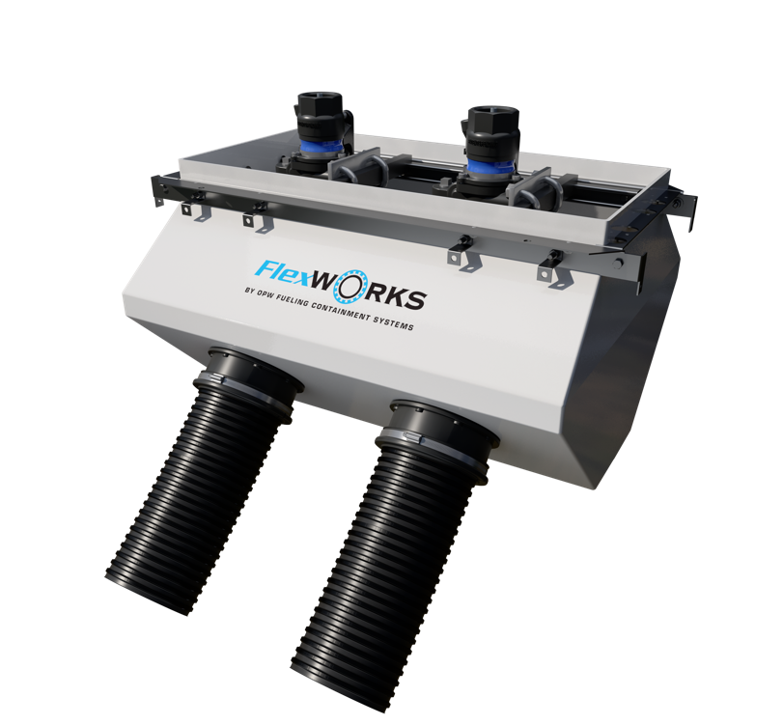
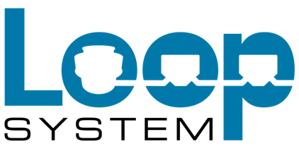
Above Ground Maintenance, Above & Beyond Performance
HIGH-FLOW LOOP SYSTEM

Slide 2
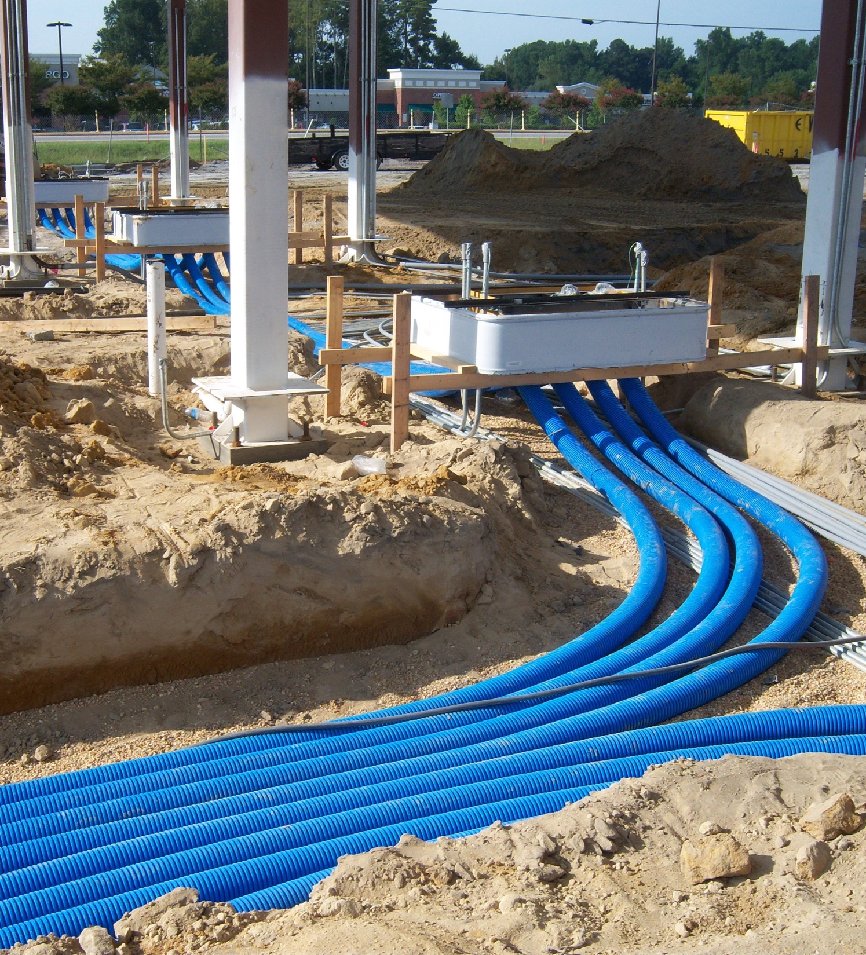
Above Ground Maintenance, Above & Beyond Performance
The Loop System from OPW is a revolutionary collection of underground fueling equipment that eliminates the need to break concrete for maintenance or repair tasks. Each component contributes to an efficient fuel-dispensing network where all service can be conducted above ground.

Slide 3
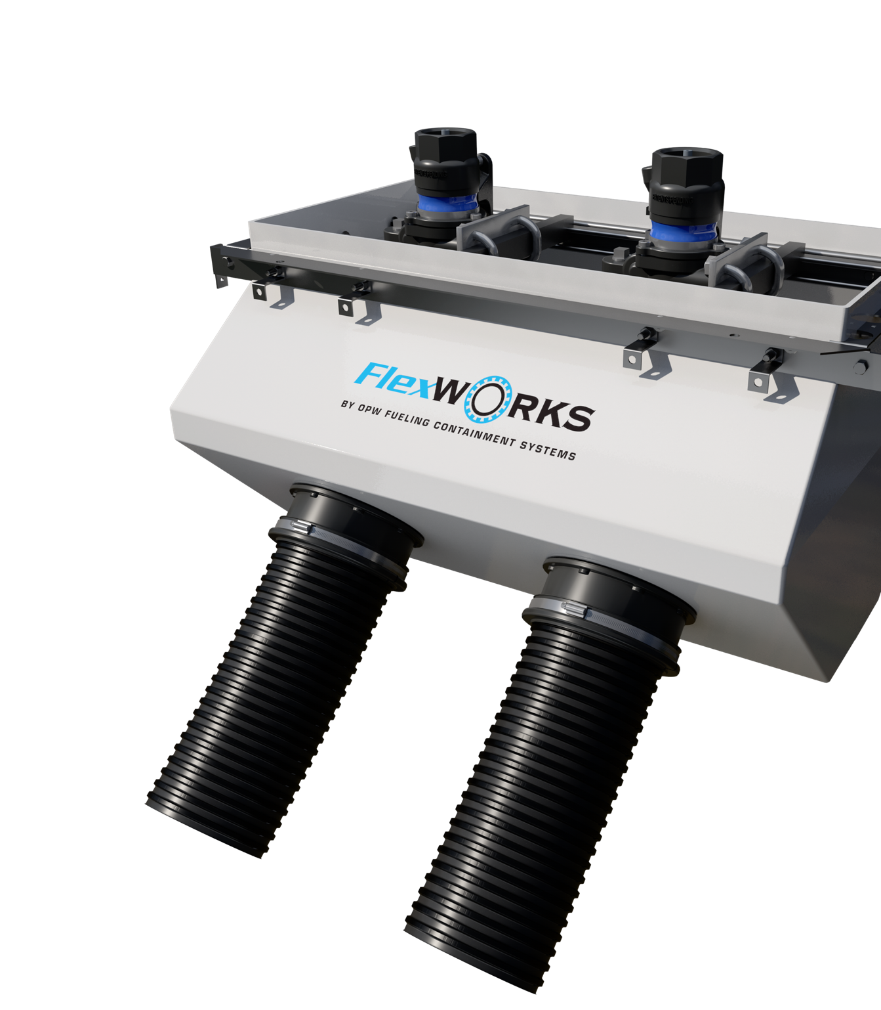
The Best - and Most Complete - Package in Underground Dispensing
Fueling stations, contractors and distributors can all benefit from this cost-effective system.
Features like prefabricated sumps, factory-installed entry fittings, elimination of shear valve riser pipes, built-in test ports and fewer pipe connections make for shorter install times, significant savings and easy access for maintenance.
The Loop System is now built to handle high-flow applications, such as diesel-fueling operations for large trucks.
3

Slide 4
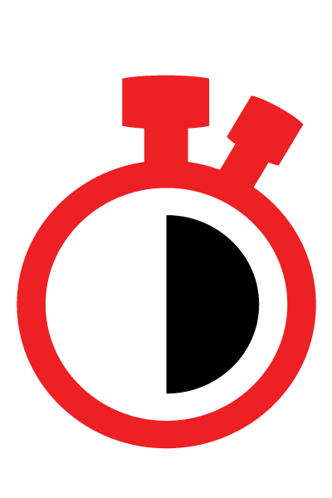
Key Features
Faster Install = Lower Costs and More Uptime
Lower Overall Cost; Helps Prevent Downtime Losses
Reduces Risk of Environmental Mishaps, Non-Compliance and Fines

Slide 5
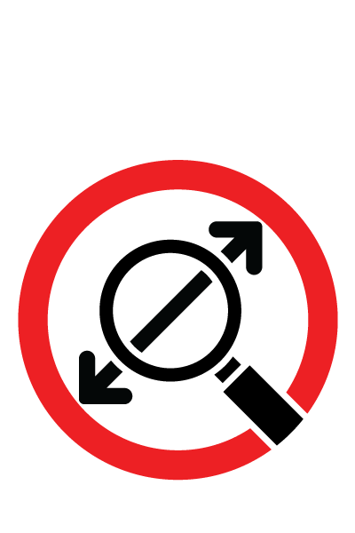
Key Features
Peace-of-Mind Assurance
Total Underground System Visibility and Rapid Response
Saves Time, Money and Hassles

Slide 6
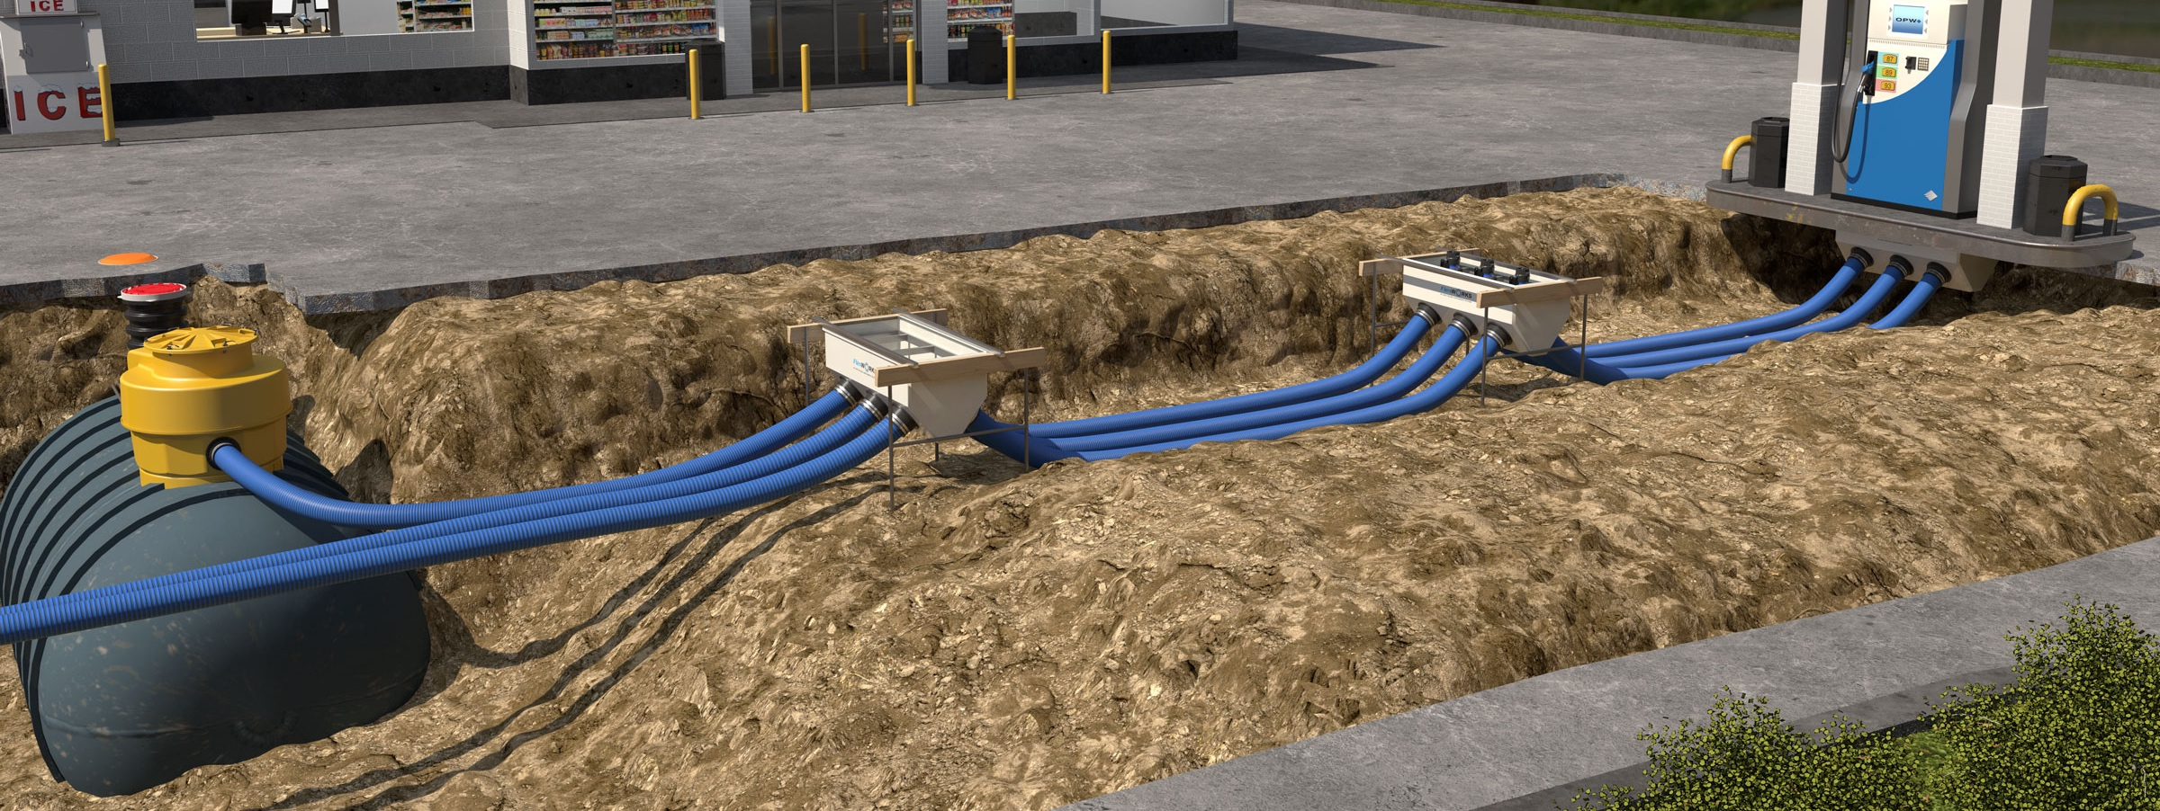
The Loop System contains fewer parts to stock and install
The state-of-the-art Loop System is made possible by a collection of completely integrated, environmentally secure components. These pre-fabricated, factory-assembled pieces translate into dramatically less field labor, associated cost and potential for installation errors. Total underground access once installed provides hassle-free inspection, maintenance and repair without excavation. Learn more about each of the contributing parts.

Slide 7
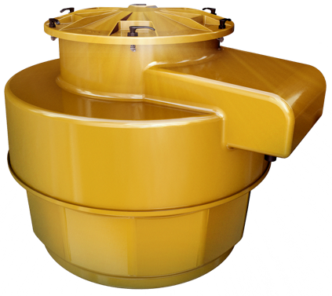
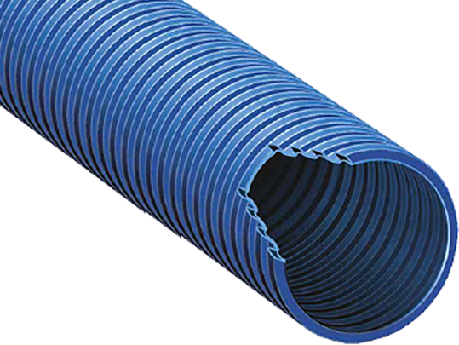
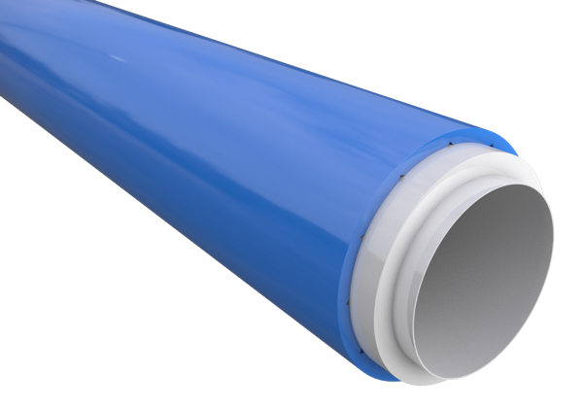
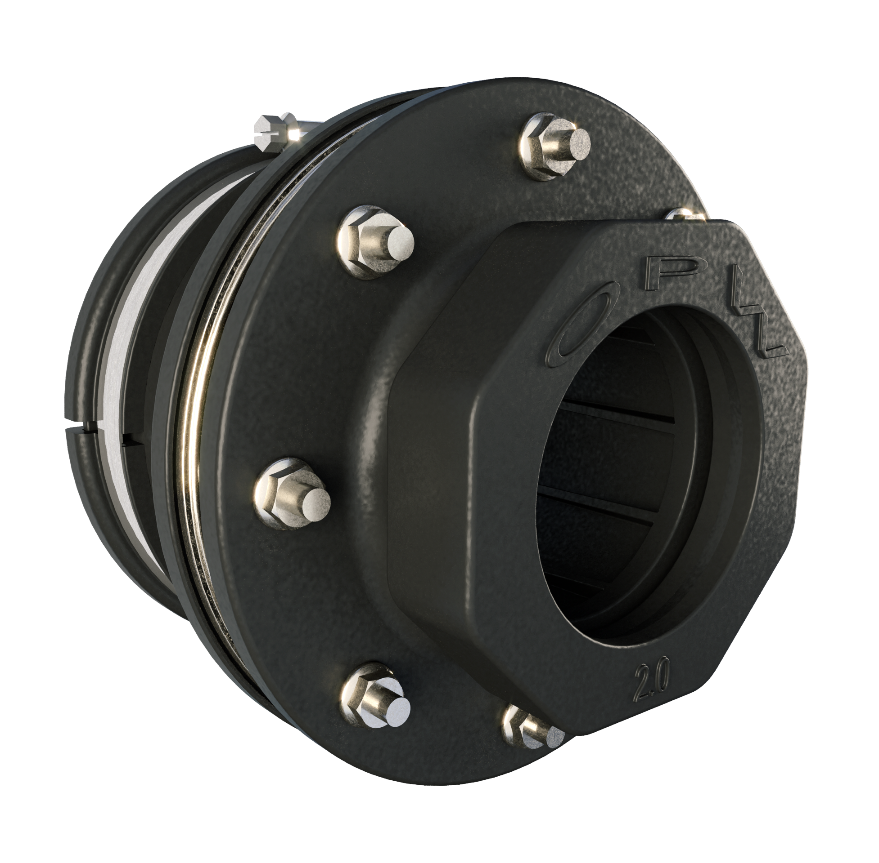
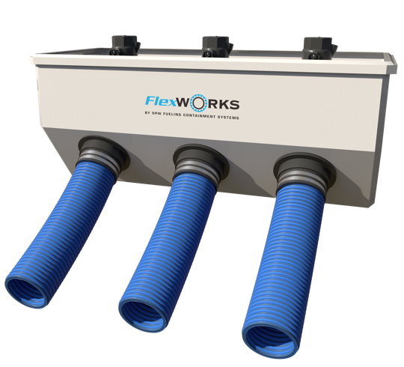
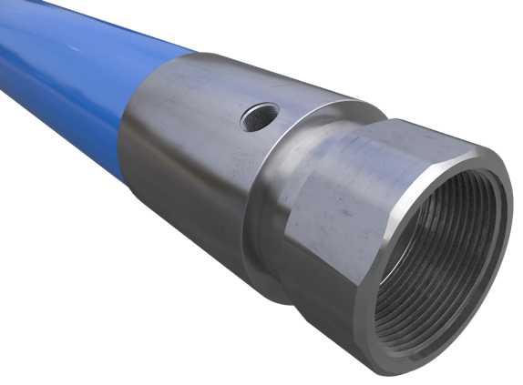
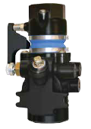
Loop System Parts
ElectroTite Tank Sumps | Dual-Layer Access Pipes | UL 971-Listed Coaxial Pipes | Dual-Sided Rigid Entry Fittings
Double-Wall Pipe Couplings (DPC) | 10 Plus Emergency Valves | Pre-Fabricated Quick- Couple Dispenser Sumps | High-Flow Dispenser Sumps

Slide 8
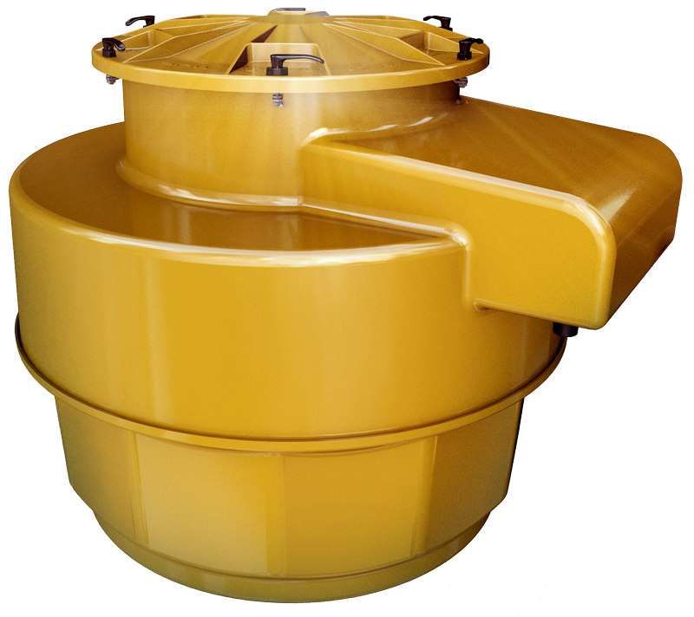
ElectroTite Tank Sumps
Eliminate the need to cut holes in sump for conduits
Reduce the number of entry and leak points
Allow space to re-route communication wires and loop additional sensors without entering sump
Integrated factory-installed junction box for seal-offs and wiring connections
Variety of Options Available

Slide 9
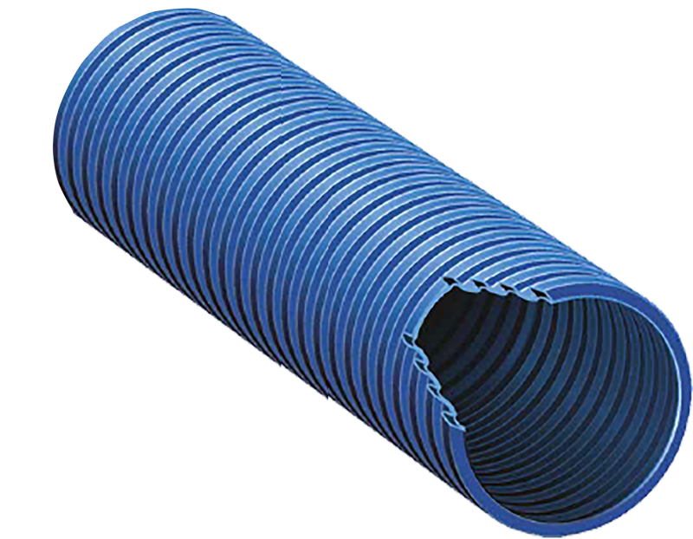
Dual-Layer Access Pipes
Resist crushing
Add extra layer of protection
Allow for easy maintenance, repair, removal and replacement without breaking concrete
Available in 4" and NEW 6"

Slide 10
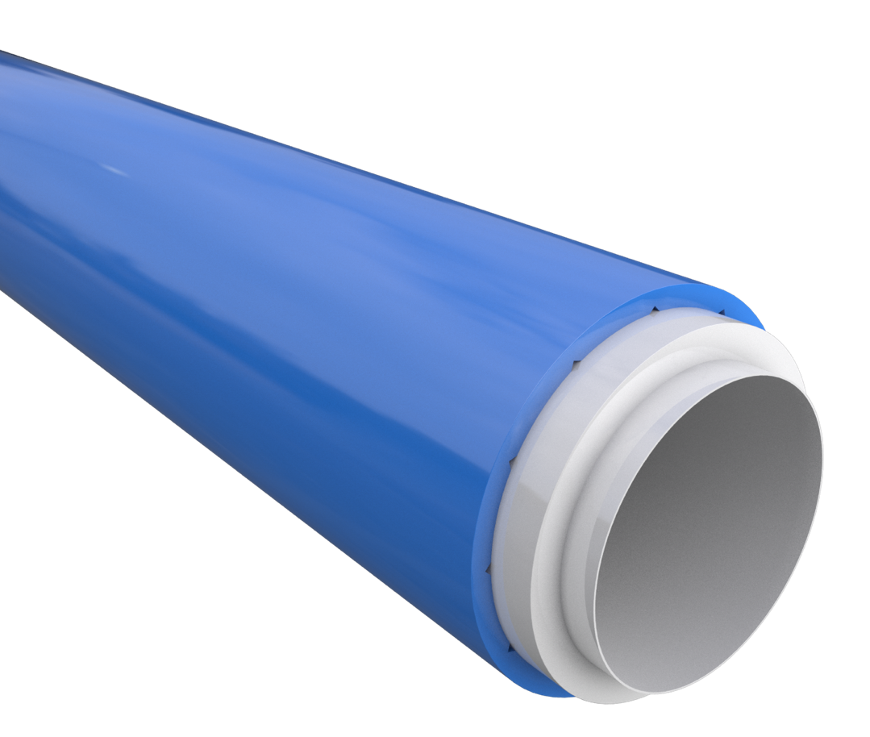
UL 971-Listed Coaxial Pipes
Easy installation
Eliminate leak points and exposed joints and fittings buried in the ground
Do not require adhesives, glues or welding
Available in .75", 1", 1.5", 2" and NEW 3"

Slide 11
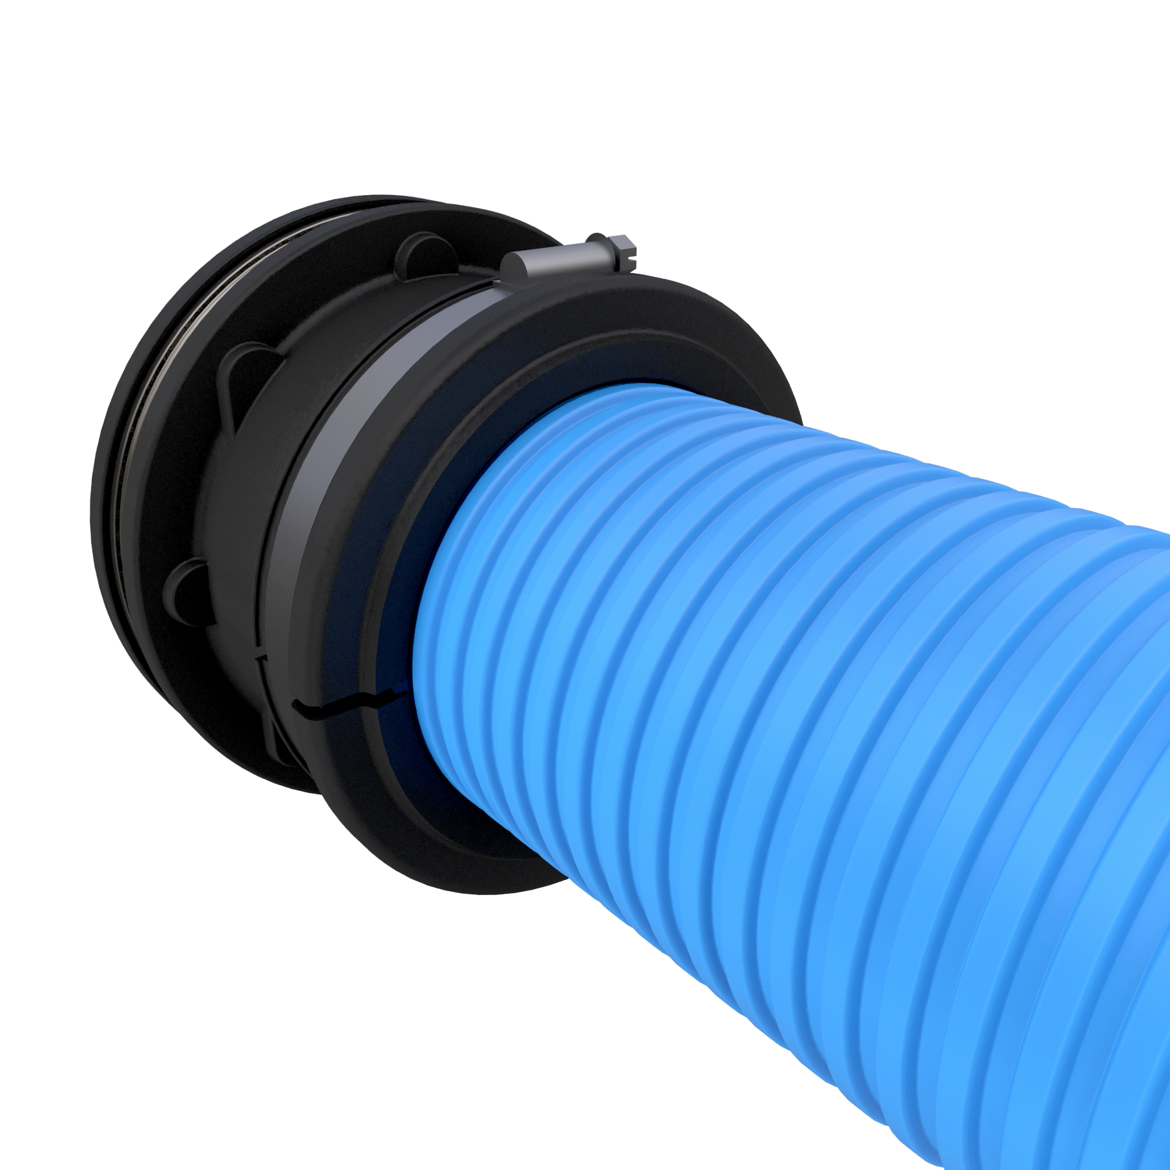
Dual-Sided Rigid Entry Fittings
Provide double containment protection
Prevent groundwater intrusion
Eliminate contamination between sump and access pipe
Designed for long-term exposure inside sump
Available in 1.5", 2" and NEW 3"

Slide 12
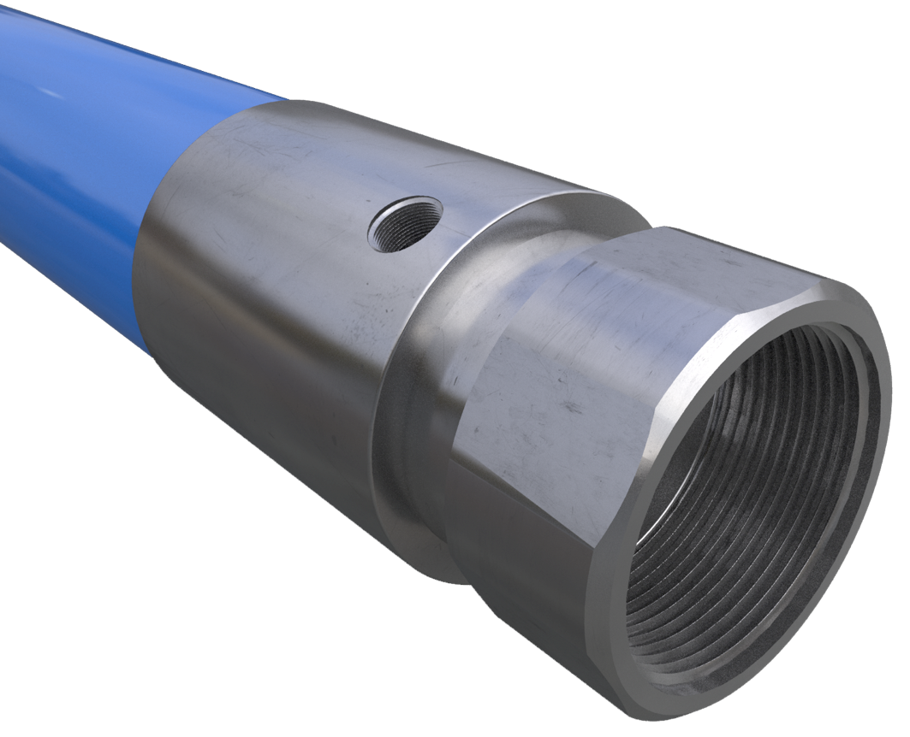
Double-Wall Pipe Couplings (DPC)
Eliminate need for rubber test boot
No trimming back secondary jackets
Allow for continuous monitoring
Stainless-steel construction compatible with all fuel brands
Available in 1.5", 2" and NEW 3"

Slide 13
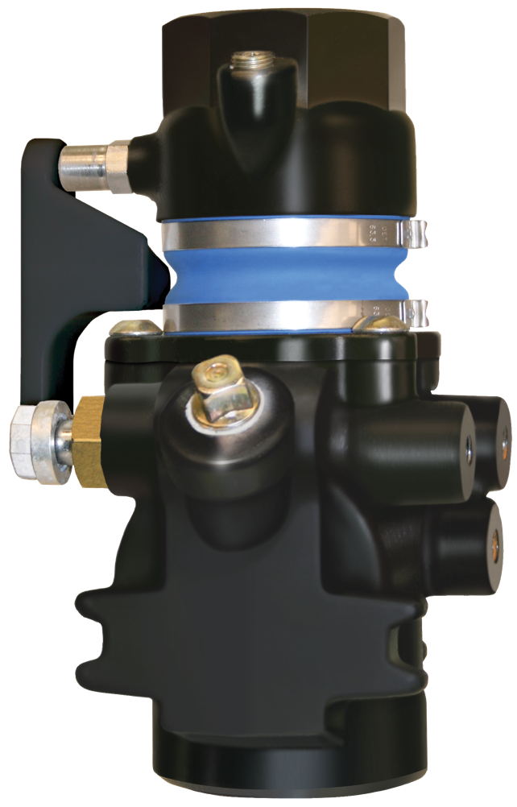
10 Plus Emergency Valves
Protect against low-impact fractures in the shear groove
Eliminate contamination and fire hazards created by leaks from fractured valves
Available in 1.5" and NEW 2"

Slide 14
Pre-Fabricated Quick-Couple Dispenser Sumps
Easy to spec
Quick access for maintenance
Fast and simple installation
Pre-assembled at factory
Variety of Options Available

Slide 15
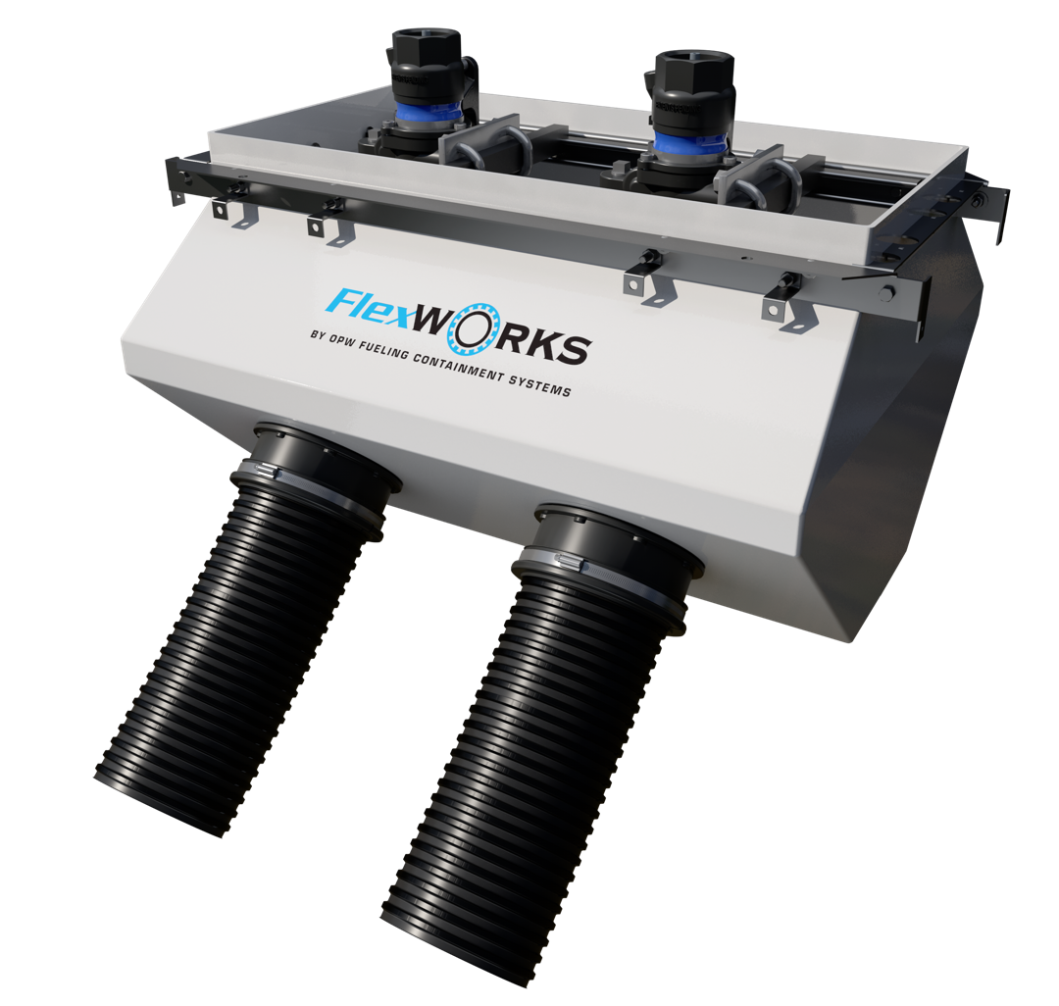
High-Flow Dispenser Sumps
Handle high-flow applications, such as retail truck stops.
Accommodate fuel dispensing on both sides of truck
New sizes to handle more demanding throughput
Variety of Options Available

Slide 16
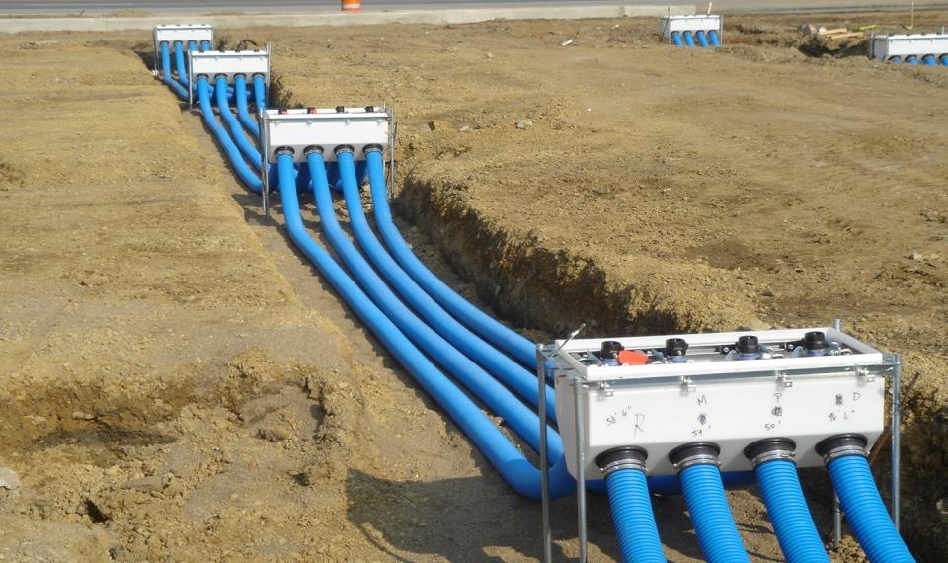
16

Slide 17
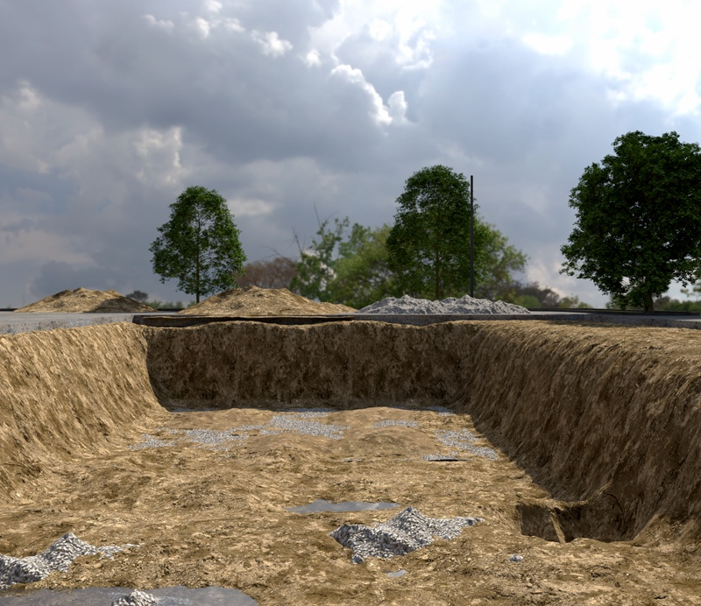
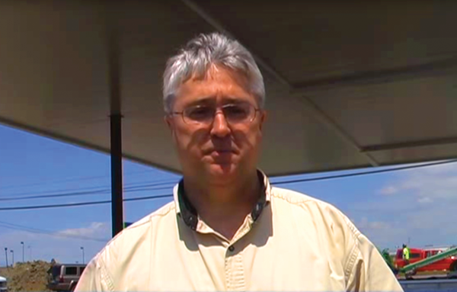
Planning
Pre-fabricated components are easy to plot out
The ordering process is simple, and distributors will have more success getting contracting crews what they need
Both distributors and contractors save valuable time
A limited number of connection points makes system design more straightforward
MARK CARTMELL | Distributor | Jones & Frank
"I can spec out the materials list for the site very easily. The numbers of fittings and parts are quite small and help me from a time-saving standpoint.”

Slide 18
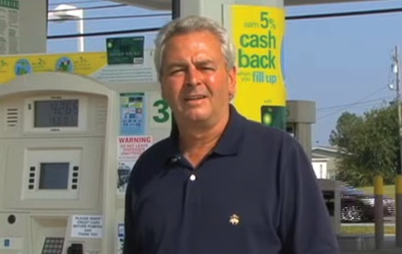
Building
Tanks in the Loop System can be buried at a shallower depth, lowering costs and time spent on excavation and backfilling
Fewer workers are needed to make connections, and there is no need for stripping pipe jackets
Time and costs get cut in half compared to the installation of traditional underground systems
Pre-fabrication allows for plug-and-play installation
JOHN GORDON | VP of Construction | Environmental, Englefield Oil Company
“I’ve found it only takes one day for installation, helping me to line up inspections early, saving us time and money.”

Slide 19
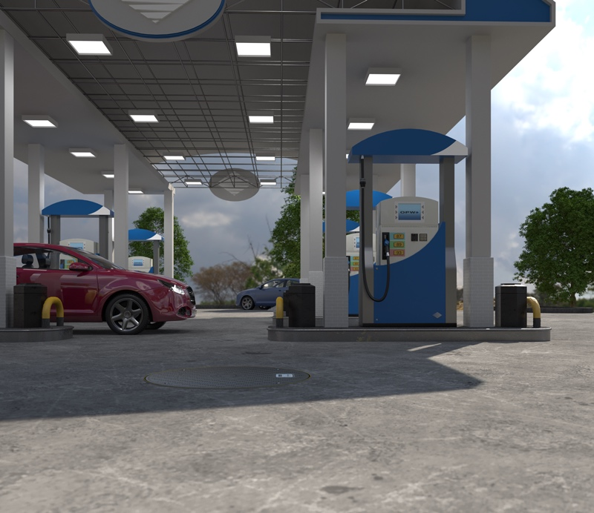
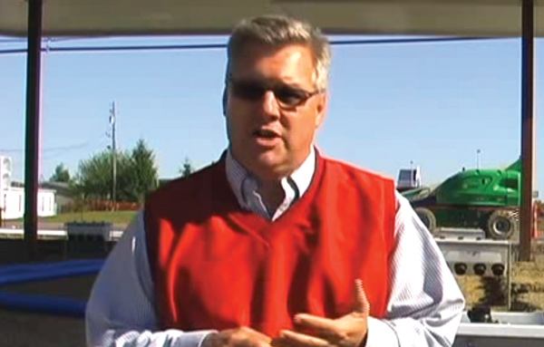
Service & Repair
Pre-fabricated components are easy to plot out
The ordering process is simple, and distributors will have more success getting contracting crews what they need
Both distributors and contractors save valuable time
A limited number of connection points makes system design more straightforward
STEVE CARSON | Contractor | Layton Excavating
“It’s easy to pull out pipe and replace it with new product in the same area without breaking concrete or removing the dispenser. We recommend the Loop System to all of our customers.”

Slide 20
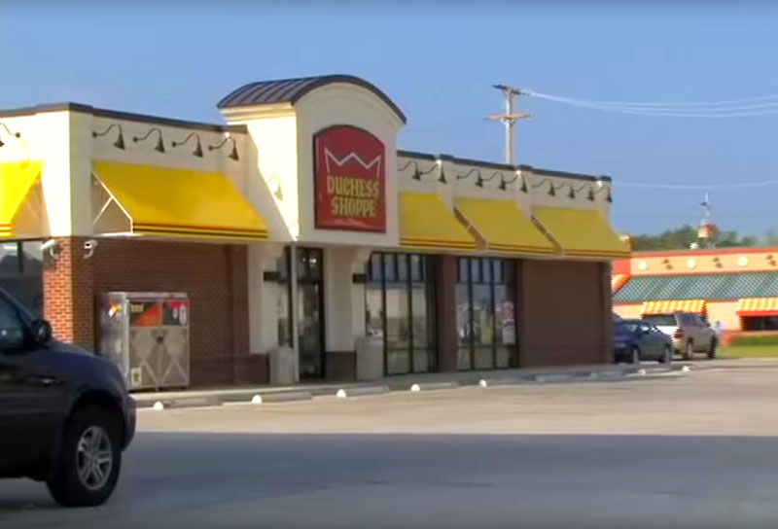
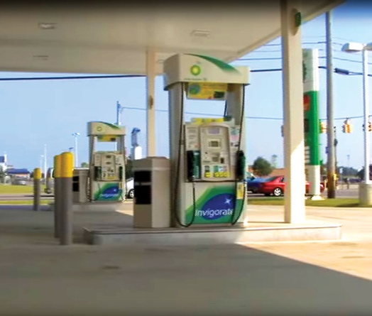
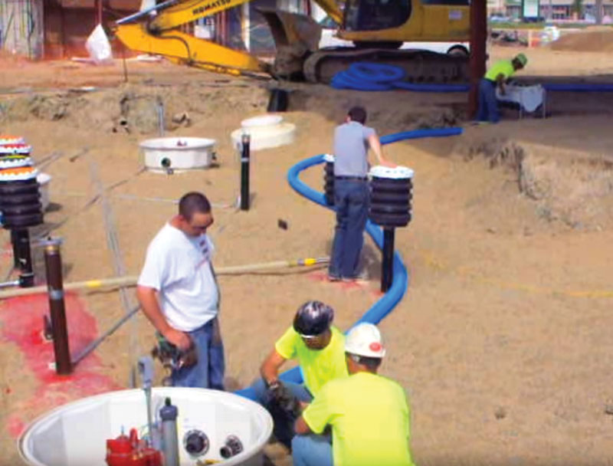
Case Study | Englefield Oil · Marion, OH
TIME IS MONEY – Layton Excavating, Inc., installed an entire piping system in one day for longtime customer Englefield Oil. What would have taken 3-4 days with a traditional system was over in a pinch, and the process created a more secure and environmentally conscious fueling location. This ease of installation for the contractor is a result of easy-to-service sumps, couplings and piping, which creates benefits for all parties involved. The contractor saved time, and the station owner experienced significant savings in excavation and backfill costs for a system that can be completely serviced above ground without the need to break concrete.
“I greatly appreciate the people and the product that OPW has. They are very dependable,” said John Gordon, Vice President, Construction and Environmental, Englefield Oil Company. “With the many Loop Systems that I have put in by OPW, I have the confidence and ability to sleep at night knowing that I have put the best product available under the ground.”
• 1,500 ft of Pipe
• 48 Couplers
• 24 Piping Runs
• 4 Tanks
INSTALL TIME:
5 Hours

Slide 21
Problems Solved by the Loop System
Access to all dispenser pipe connections without removal of the dispenser
Makes visual inspections and cleaning of dispenser sumps easier
Dispenser sumps will not deform due to backfill or ground water pressure
Eliminates ground water infiltration
Drastically reduces the number of pipe fittings & associated assembly labor
Eliminates field fabrication of steel risers
Eliminates the need for expensive flex connectors
Eliminates the need for rubber test boots
Eliminates the need to cut back the pipe’s secondary jacket

Slide 22
Problems Solved by the Loop System
Eliminates the need to field adjust the height of dispenser sumps
Eliminate the need to try and make a curved pipe go straight
Greatly reduces the time and water to hydrostatically test sumps
Provides quick and effective means to re-test secondary containment
Allows pipe inspection or replacement without the need for excavation
A pipe section can be retracted without removing dispenser from island
Reduces the number of piping joints
Provides a lower installed cost than systems with deep dispenser sumps

Slide 23
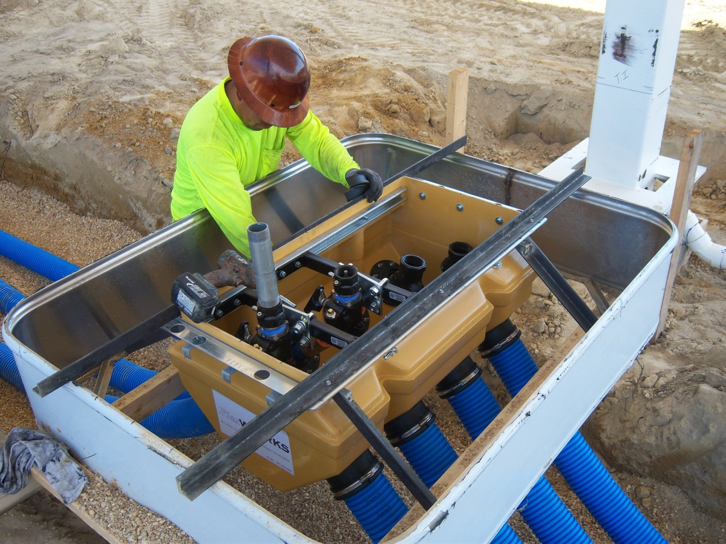
What’s in it for Me?
Site Owner
Less Contractor Dependent Installation + Top of The Line Components = Better Site Integrity and Performance
Total Accessibility to all Underground Equipment without Excavation = Lower Cost of Ownership
Contractor
Reduced Installation Complexity (Plug & Play) + Quick, Bullet Proof Site Installation/Testing = Less Opportunity for Errors/Call Backs and a Profitable Job
Regulator
Better Installation + Better Components + Better Maintenance and Monitoring Capability = No Gas in the Ground

Slide 24
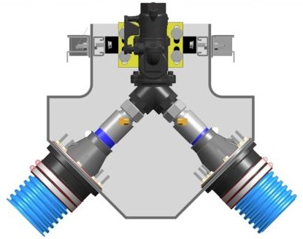
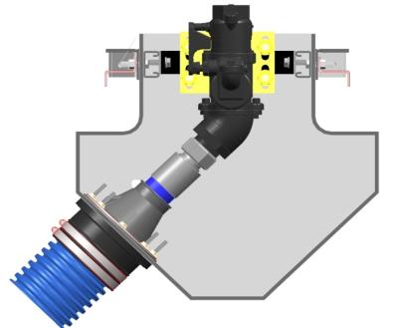
Quick Connect Dispenser Sumps
Junction Dispenser Sumps
Terminating Dispenser Sumps

Slide 25
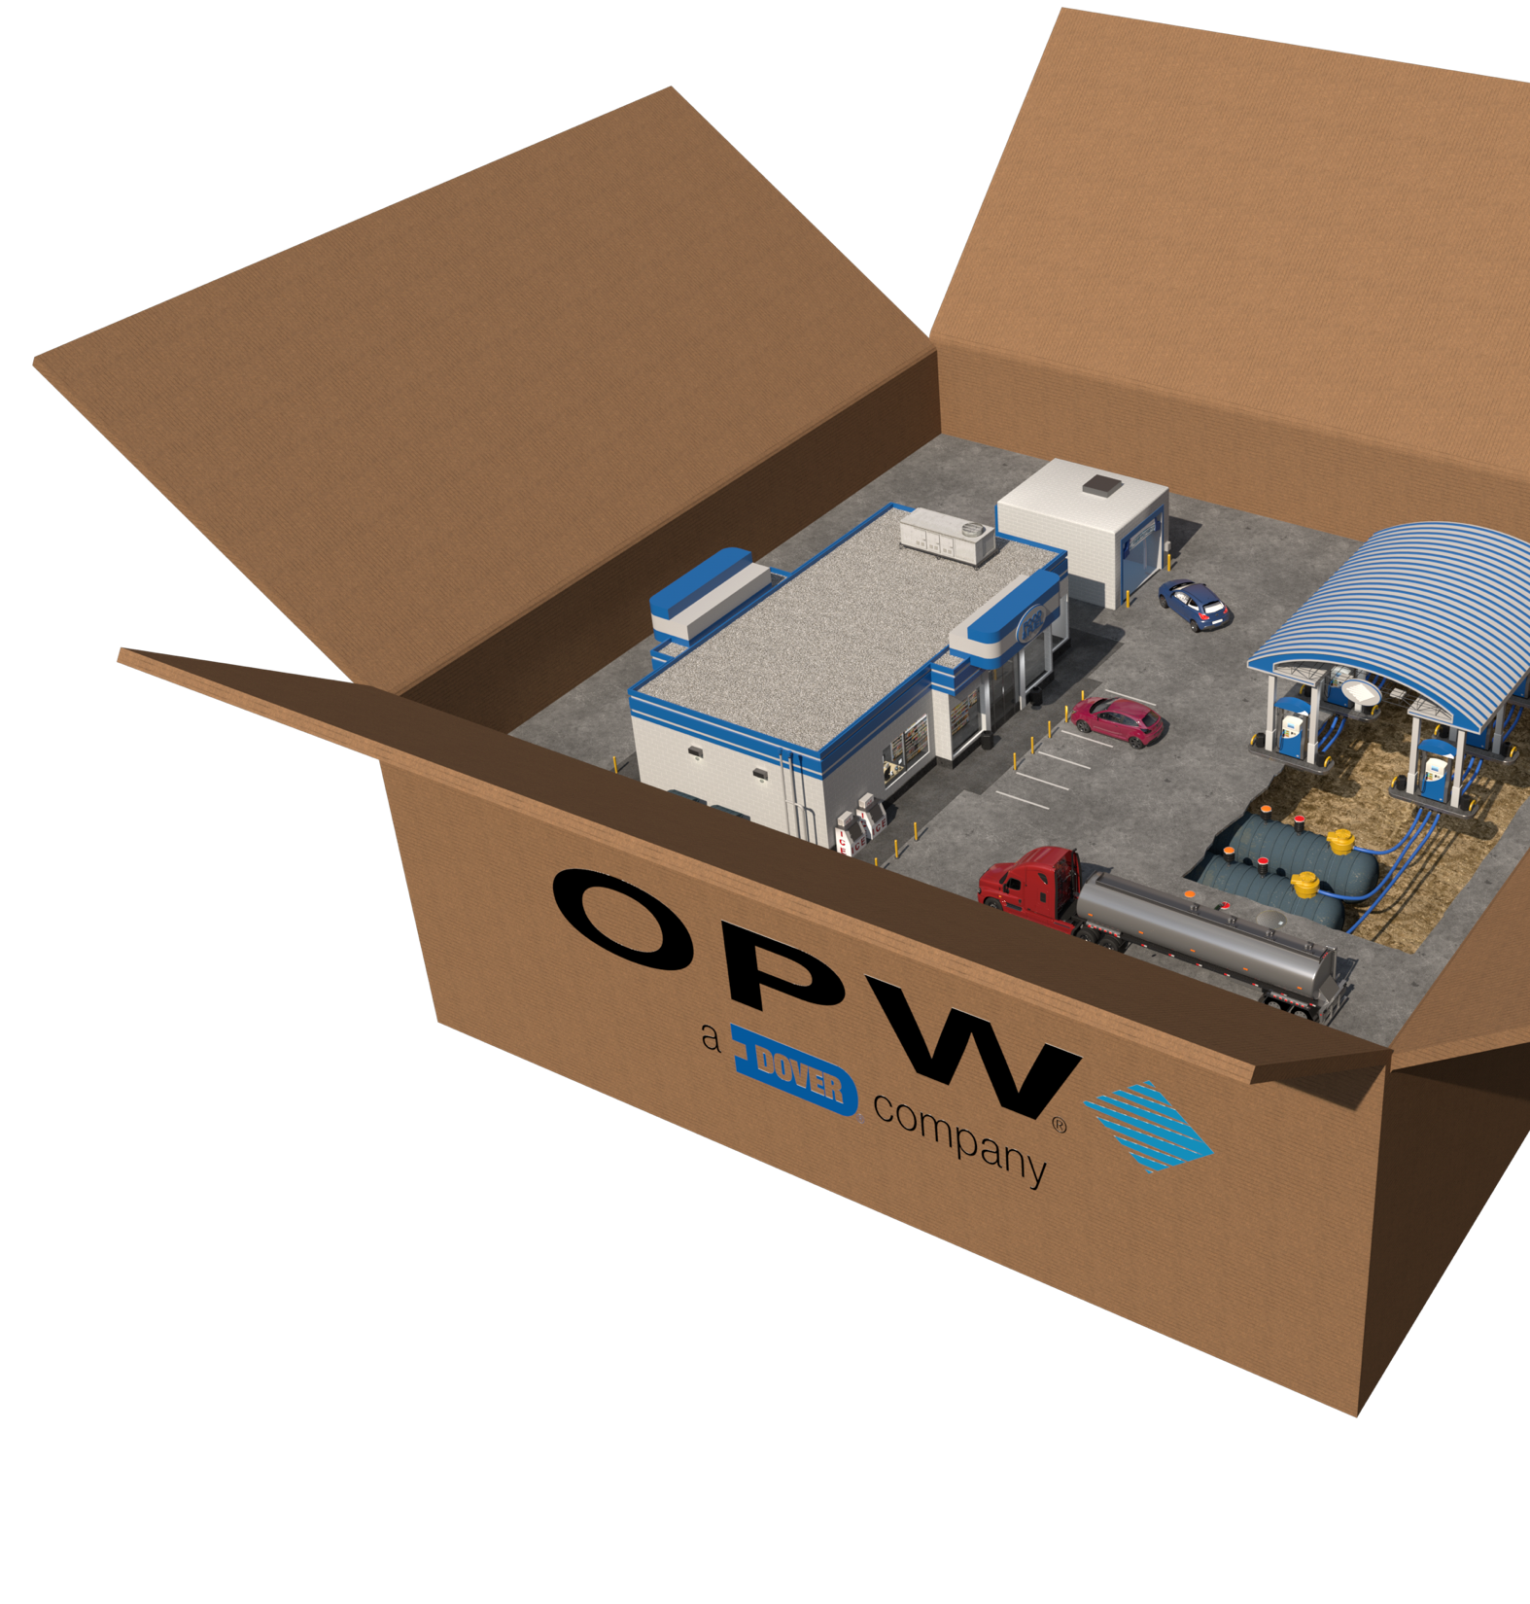
The Best - and Most Complete - Package in Underground Dispensing
From concept to completion, OPW provides a total solution that makes life easier for all parties.
Starting by simplifying the spec process, OPW saves plenty of headaches throughout the construction of its Loop System. The plug-and-play nature of the system makes builds faster and more efficient, while providing an ease of service that is unparalleled. Distributors, contractors and fueling stations get to enjoy the innovative design of the Loop System and its benefits.
25

Slide 26
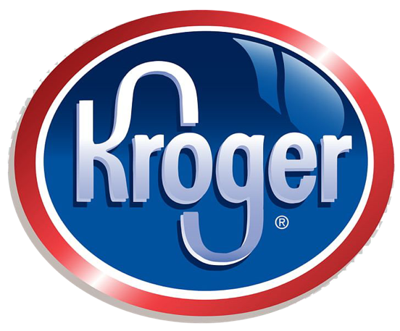
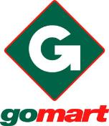
Who Is Specifying the Loop System?

Slide 27
Thank You!

